Slide 1

Product Injuries
Insights and Trends
Tami McManus
April 2024

Slide 2

Agenda
Introduction
Objectives & Scope
Project Methodology
Data
Findings
Recommendations

Slide 3


Introduction
The Consumer Product Safety Commission maintains a surveillance system (NEISS) to track injury data related to consumer products. The data is collected from a representative sample of emergency rooms in the United States, covering more than 45 years.
This project will explore the NEISS injury data from 2013 through 2022.

Slide 4
Objectives & Scope
Trend Analysis:
Review the injury data published by NEISS and explore trends related to:
Number of injuries
Product categories
Type and severity of injuries
Patient demographics
Scope:
This project covers injury data from 2013 through 2022.

Slide 5
Project Methodology
Based on CRISP-DM Methodology
Understand Business
Define:
Understand Data
Prepare Data
Address:
Explore & Analyze
Statistical
Validate & QA
Visualize & Present
Review Findings
Finalize:
Gather background information
Collect data
Explore data
Missing data
Duplicates
Data errors
Outliers
Verify data integrity
Objectives
Scope of work
Deliverables
Descriptive
Correlation
Trend
Validate:
Process
Checkpoint – Are Objectives Met?
Documentation
Visualizations
Presentation
Next Steps
Perform Analysis:
Data
Load data
Preview data

Slide 6

Data

Slide 7
Data Overview
Source:
US Consumer Product Safety Commission
Description:
Data reported from a representative sample of hospitals for all emergency room visits related to a consumer product
Methodology:
The sample design and implementation documentation is available on the NEISS website.

Slide 8
Data Notes
Write-In Values Excluded
Other Race, Other Diagnosis, Other Diagnosis 2, Narrative, and Narrative 1 data were excluded from analysis
Data Set Changes
Hispanic, Body Part 2, and Diagnosis 2 data were added in 2019. For consistency, these data were excluded from analysis
Product Categories
As there are more than 1000 products tracked, product categories were created to simplify analysis

Slide 9
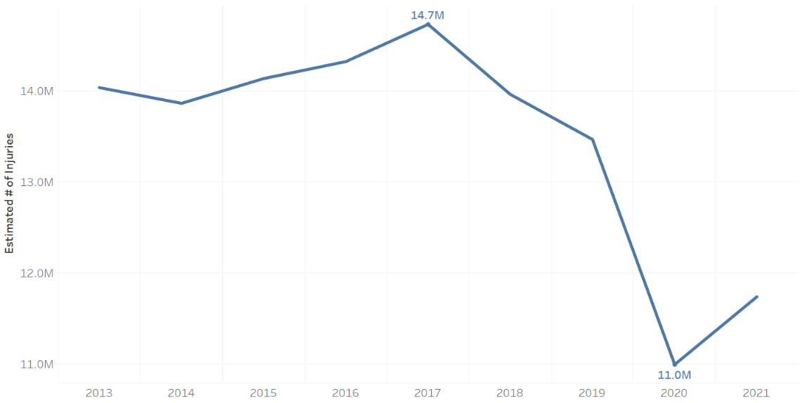
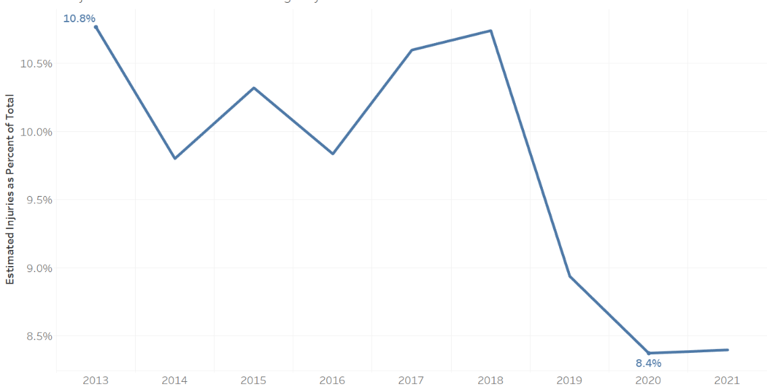
Product Injuries by Year
Estimated Injuries
Estimated % of Total ER Visits
Product-related injuries seen at the emergency room reached a low in 2020 of ~11M. While the estimated number of injuries increased in 2021, the number of product-related injuries as a percent of all visits remained flat.

Slide 10
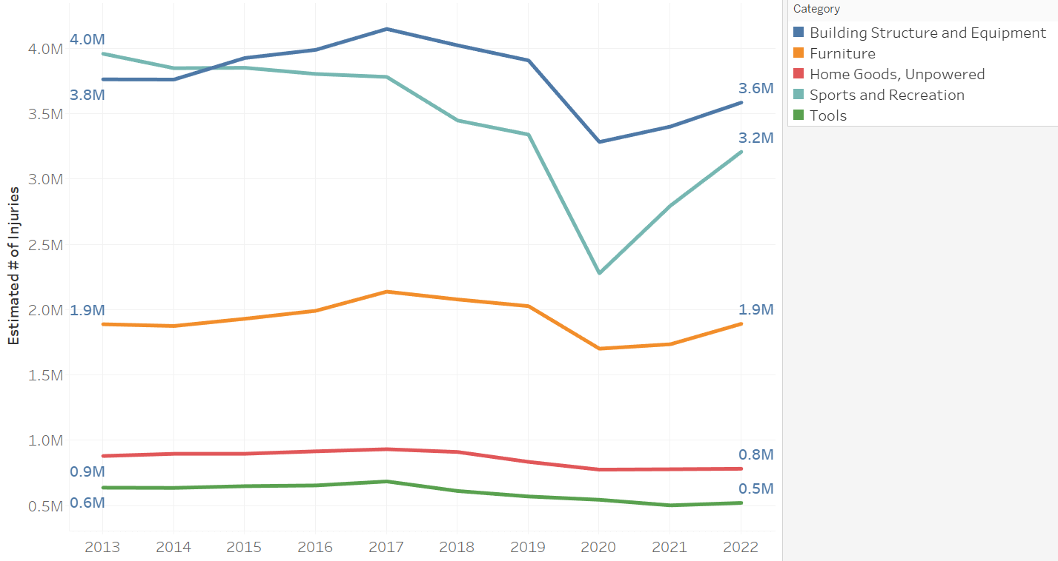
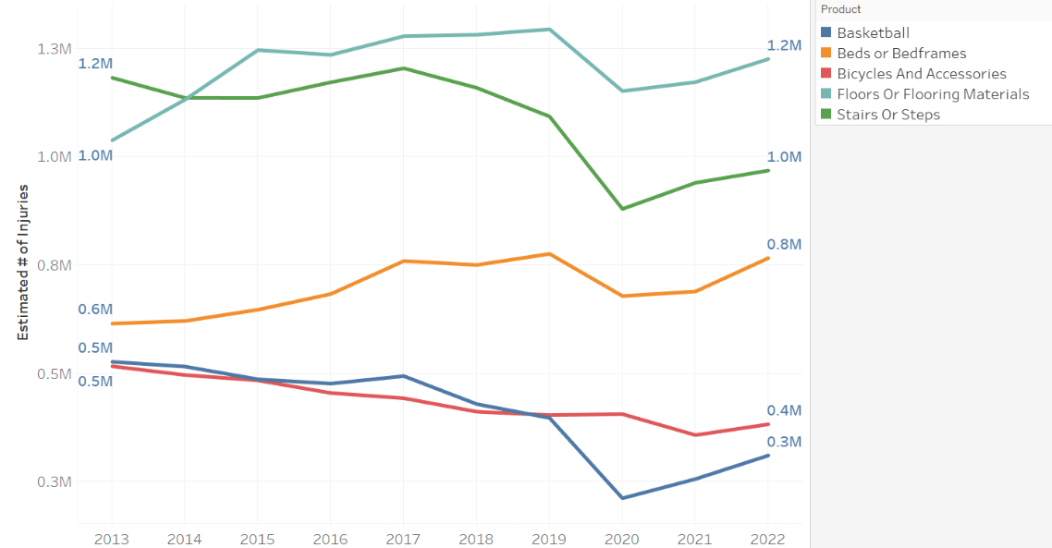
Products Involved in Injuries
Top 5 Product Categories
Top 5 Products
The top five product categories have remained unchanged from 2013 to 2022. Floors and stairs take the top two spots in products, aligning with the top category of Building Structure and Equipment. Beds, Bicycles, and Basketball round out the top 5 products.

Slide 11
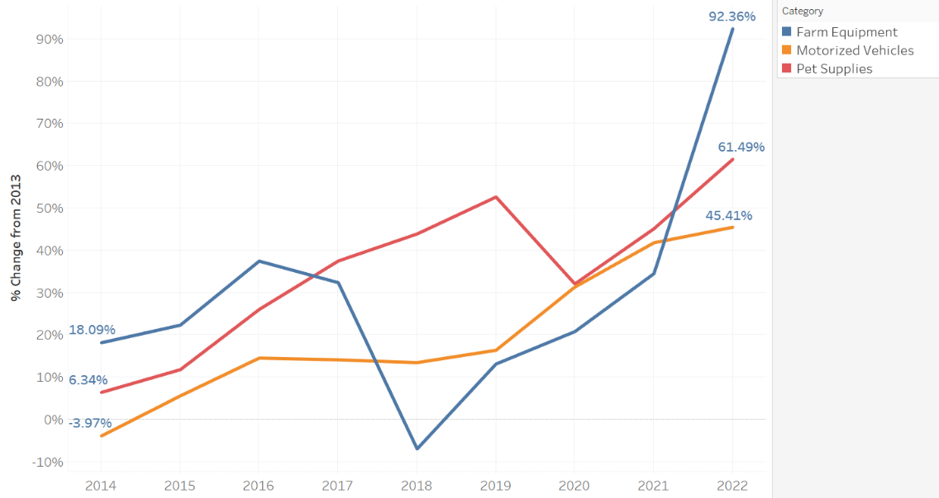
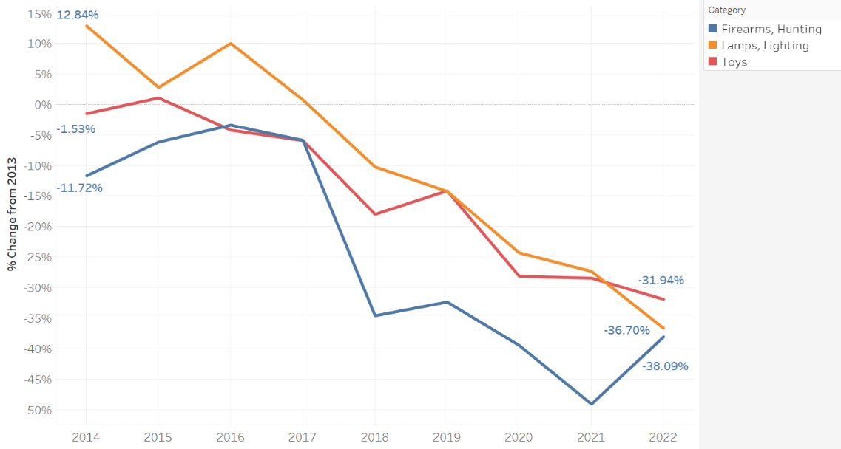
Products Involved in Injuries
Largest Increase from 2013
Largest Decrease from 2013
Injuries related to Farm equipment showed the largest increase and toy-related injuries showed the largest decrease.

Slide 12
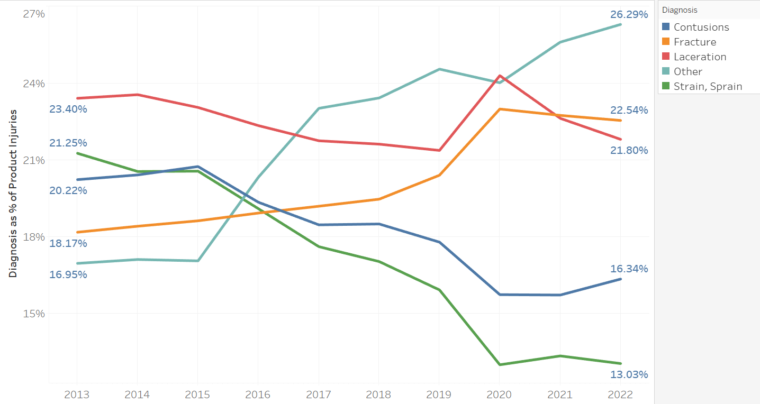
Diagnosis of Product Injuries
Top 5 Diagnosis
Most product-related injuries are relatively minor – cuts, bruises, sprains, and broken bones.
Despite a total of 29 different pre-defined diagnoses, the most common diagnosis is “Other”.

Slide 13
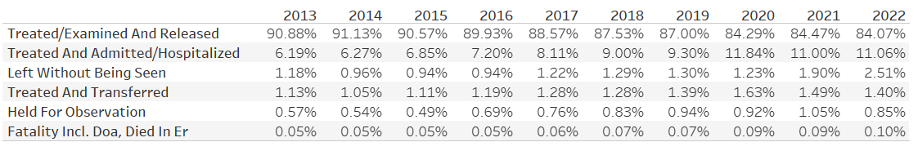
Disposition of Emergency Room Visits
Dispositions as a Percentage of Product-Related Injuries
“Treat and release” visits make up the largest portion of product-related emergency room visits, even though they decreased by 6.79% between 2013 and 2022. Increases in hospital admissions and people leaving the emergency room without being seen made up the difference.

Slide 14
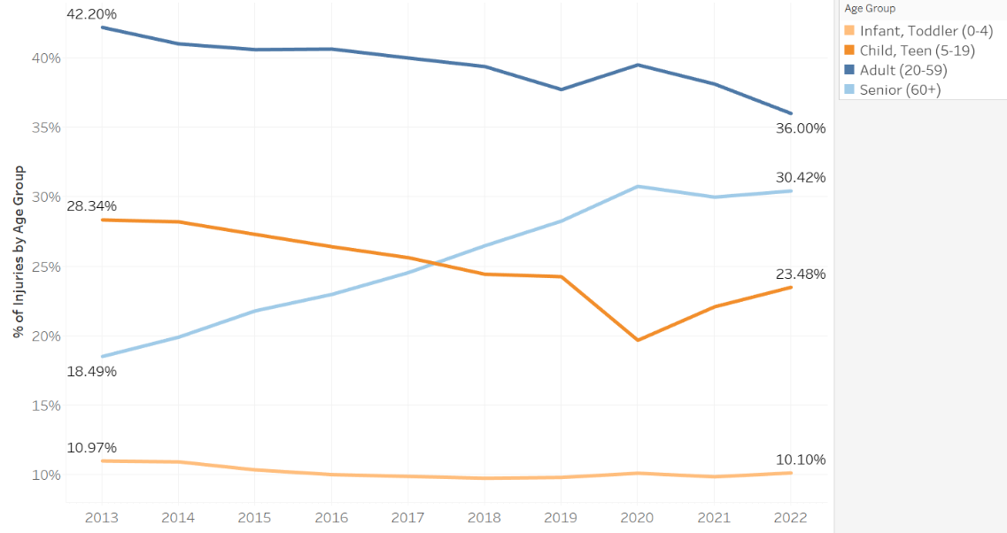
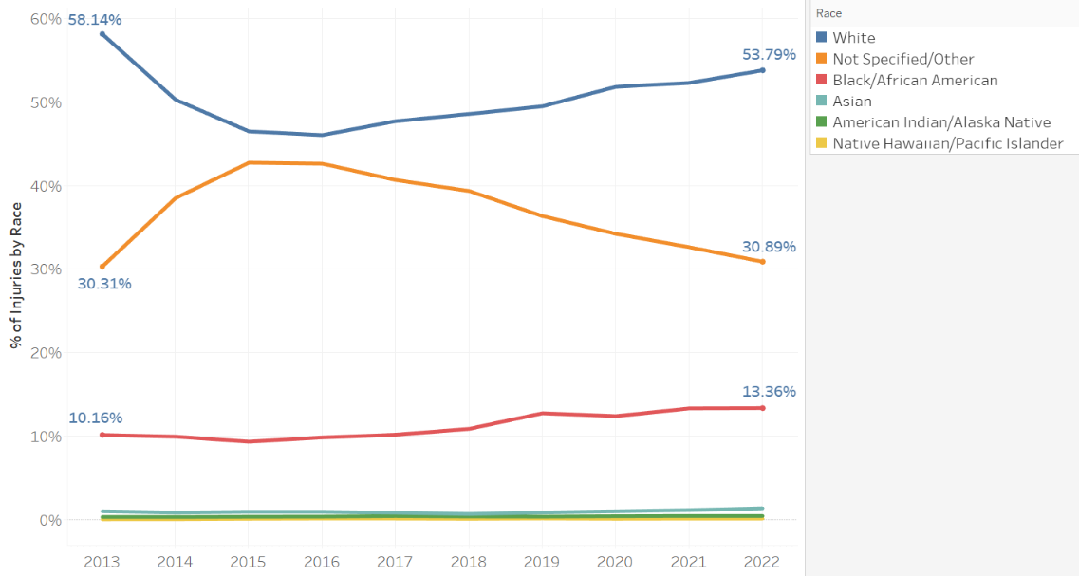
Demographics
Age
Race
The percentage of injuries in the senior age group increased by almost 12% from 2013 to 2022. Injuries reported with a race of “Other” or “Not Specified” is the largest group behind white emergency room visitors.

Slide 15
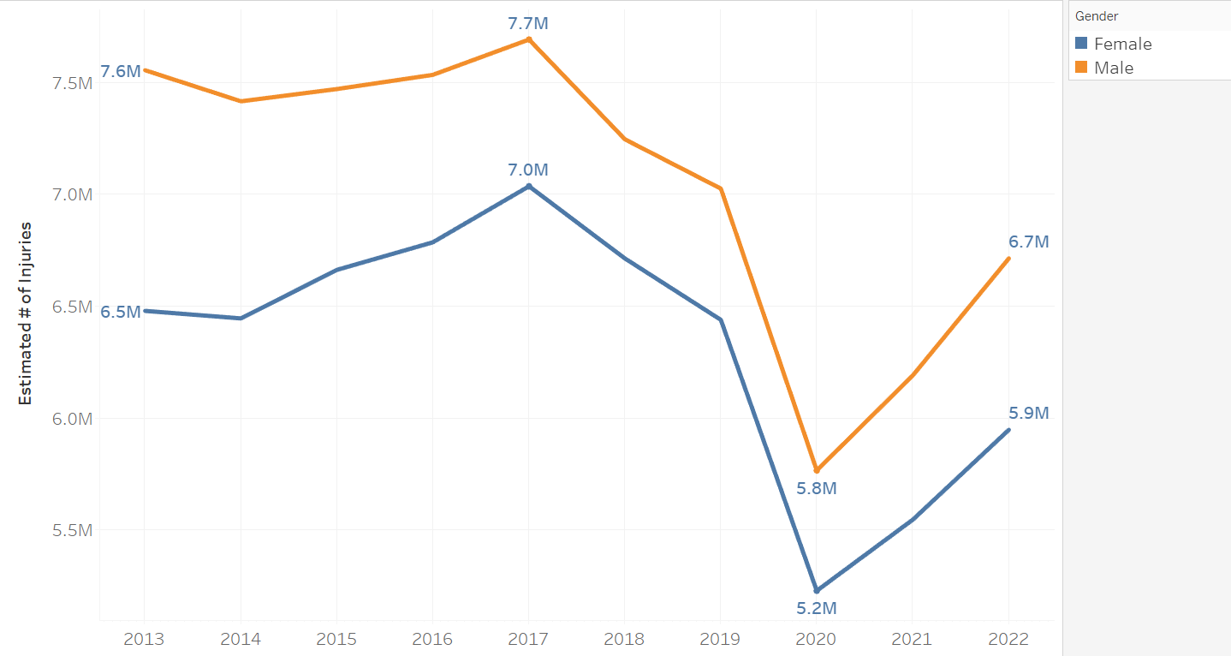
Demographics
Sex
The split between males and females has remained consistent, with men having a slightly higher injury rate.
Note: Before 2019, the options for recording sex were Male, Female, and Not Recorded. Injuries reported for non-binary patients were statistically insignificant at ~ 4,000.

Slide 16
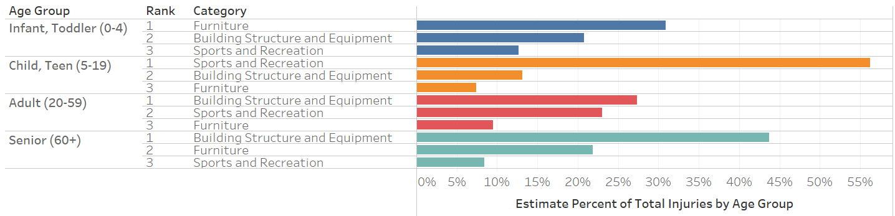
Demographics
Estimated Injuries by Age Group and Category (Top 3, for 2022)
The top injury-producing product category changes for each age group, except Seniors – who have the same top category as Adults. However, the top 3 product categories are the same across all age groups.

Slide 17
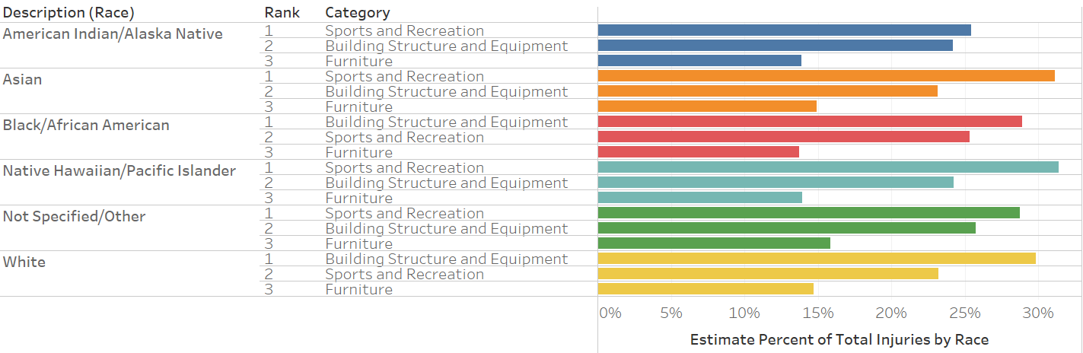
Demographics
Estimated Injuries by Race and Category (Top 3, for 2022)
Building Structures and Equipment are the top product categories for White and African American patients, followed by Sports and Recreation. For all other racial groups, the top two product categories are reversed, with Sports and Recreation taking the top spot.

Slide 18
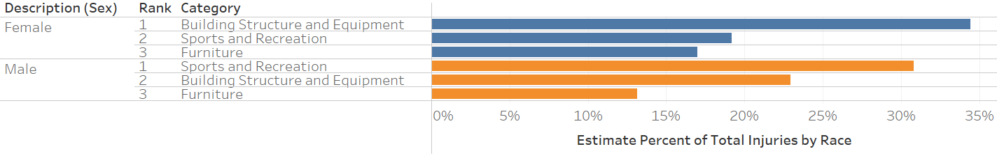
Demographics
Estimated Injuries by Race and Category (Top 3, for 2022)
The top product category for women is Building Structure and Equipment, while Sports and Recreation takes the top spot for men.

Slide 19



Findings
The number of emergency room visits related to product injuries decreased from ~14.7 million in 2017 to ~11.0 million in 2020.
The percentage of product-related emergency room visits as compared to all emergency room visits decreased from 10.6% in 2017 to 8.4% in 2020.
The most common product categories involved in injuries have not changed from 2013 to 2022:
Building Structure and Equipment (#2 in 2013-4)
Sports and Recreation (#1 in 2013-4)
Furniture
Home Goods, unpowered
Tools

Slide 20



Findings
Product injuries related to Farm Equipment increased the most, ~92%, between 2013 and 2022.
Product injuries related to Firearms and Hunting Equipment decreased the most, ~38%, between 2013 and 2022.
For 5 of the 10 years covered in this analysis, the most common injury type related to products is “Other”.
Adults (20-59 yo) make up the largest portion of emergency room visits related to product injuries, with Infants and Toddlers (0-4 yo) having the smallest number of visits.
While the order of the top 3 product categories changed based on sex and race, the categories did not change:
Building Structure and Equipment
Sports and Recreation
Furniture

Slide 21
Next Steps – Future Analysis
Impact of COVID-19 Pandemic
Can the significant drop in ER visits for product injuries be tied to COVID-19?
Product Categories
The assignment of categories was an ad-hoc process. How has this impacted the analysis? Is there a generally accepted way to categorize products?
Other Diagnosis
Given that “Other” is the top diagnosis for 5 of the 10 years examined, analysis of the Other Diagnosis text field may shed light on why so many injuries are not covered by the 29 predefined values

Slide 22
Next Steps – Future Analysis
Demographics
Do the product injuries by age group, sex, and race align with proportions in the general population?
Correlation Analysis
Perform formal correlation analysis on the data set

Slide 23


THANK YOU

Slide 24
Appendix A – Source Data
“Archived Annual NEISS Data.” 2013 – 2022, United States Consumer Product Safety Commission, [Microsoft Excel], https://www.cpsc.gov/cgibin/NEISSQuery/home.aspx. Accessed Jan 24, 2024.
“NEISS Data Dictionary.”, United States Consumer Product Safety Commission, [Microsoft Excel], https://www.cpsc.gov/s3fs-public/DataDictionary042022.xlsx?VersionId=ZudA.bM6W3epO1LHUp_XwQjL8q7zIgvD. Access Feb 1, 2024.
National Center for Health Statistics. Emergency Department Visits in the United States, 2016-2021. Generated interactively: April 30, 2024 from https://www.cdc.gov/nchs/dhcs/ed-visits/index.htm
“National Electronic Injury Surveillance System (NEISS)”, United States Consumer Product Safety Commission, https://www.cpsc.gov/Research--Statistics/NEISS-Injury-Data. Accessed Apr 18, 2024.

Slide 25
Appendix A – Source Data
Rui P, Kang K. National Hospital Ambulatory Medical Care Survey: 2015 Emergency Department Summary Tables. Available from: http://www.cdc.gov/nchs/data/ahcd/nhamcs_emergency/2015_ed_web_tables.pdf
Rui P, Kang K. National Hospital Ambulatory Medical Care Survey: 2014 Emergency Department Summary Tables. Available from: http://www.cdc.gov/nchs/data/ahcd/nhamcs_emergency/2014_ed_web_tables.pdf
Rui P, Kang K, Albert M. National Hospital Ambulatory Medical Care Survey: 2013 Emergency Department Summary Tables. Available from: http://www.cdc.gov/nchs/data/ahcd/nhamcs_emergency/2013_ed_web_tables.pdf

Slide 26
Appendix B - Documentation
“National Electronic Injury Surveillance System (NEISS).” United States Consumer Product Safety Commission, https://www.cpsc.gov/Research--Statistics/NEISS-Injury-Data. Accessed Feb 1, 2024.
“NEISS Coding Manual.” United States Consumer Product Safety Commission, https://www.cpsc.gov/s3fs-public/January-2024-NEISS-CPSC-only-Coding-Manual.pdf?VersionId=bEaz2iKYDAlz8KA60KEKKrLrXZW3kLOj. [PDF]. Accessed Jan 24, 2024.
“NEISS Sample Design 1997-Present.” United States Consumer Product Safety Commission, https://www.cpsc.gov/s3fs-public/pdfs/blk_media_2001d011-6b6.pdf. [PDF]. Accessed Apr 19, 2004.

